Slide 1
EDA of HR Analytics
HR Employee Attrition data

Slide 2
HR Employee attrition : Overview
Overview:
Employees are the backbone of any organization. Impact of Attrition in an organization can be categorized as below.
- Loss of experienced employees.
- Negatively affect productivity/profit.
- Increase in training cost.
Problem Statement:
- What factors are contributing more to employee attrition?
- What type of measures should the company take in order to retain their employees?

Slide 3
Methodology/process followed
Sample employee data of ~ 1470 considered for analysis.
Packages used numpy, pandas, seaborn , matplotlib, pandas profiler.
Identified dependent column as Attrition, dropped columns not needed for analysis, grouped numerical, continuous, categorical columns as list as part of data cleansing and pre profiling.
Created respective univariant and Bivariant Visualization for Categorical, Numerical columns .
EDA performed using above to derive conclusions.

Slide 4
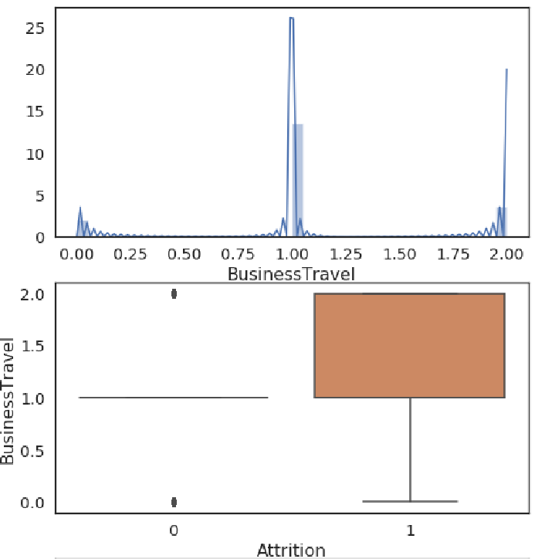
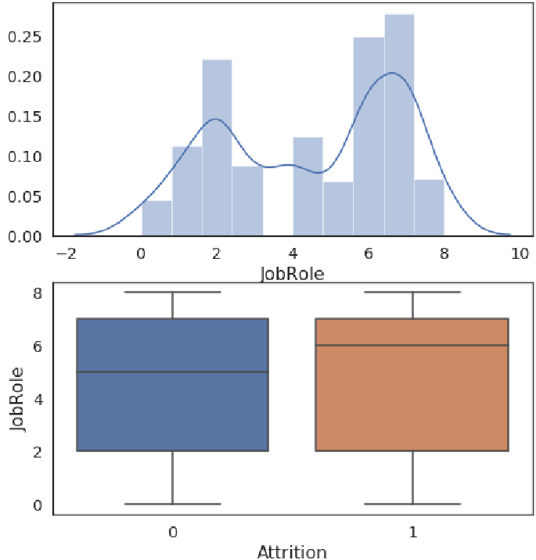
Categorical value analysis: ('BusinessTravel', 'Department', 'EducationField', 'Gender', 'JobRole', 'MaritalStatus')
2 – travel frequently
1 – travel rarely
Attrition is high for frequent travelers (2), Lower job roles

Slide 5
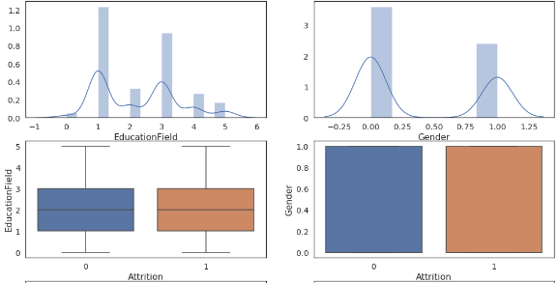
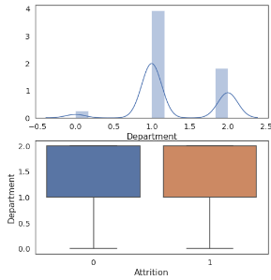
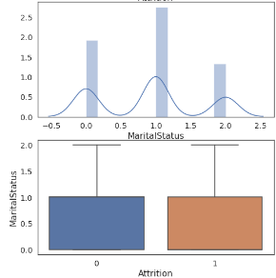
Categorical value analysis - Continued
Attrition is high among Male gender(0), Research and development(1) department
Single marital status(1) are more likely to quit than Married, and Divorced.
Education field does not have major impact .
s

Slide 6
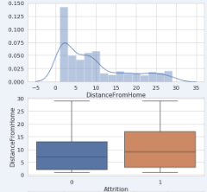
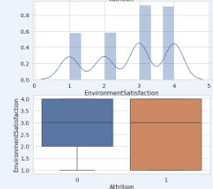
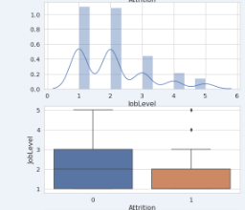
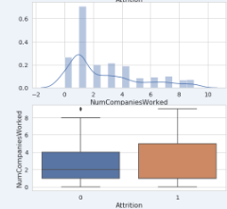
Numerical value analysis – (Count < 30)
Farther employee stay from office, more is attrition
Employees at Lower Job level are more likely to quit.
Environment Satisfaction is spread across and has relatively lesser impact on the determination of Attrition of employees.
more NoofCompaniesworked more likely attrition.

Slide 7
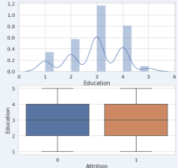
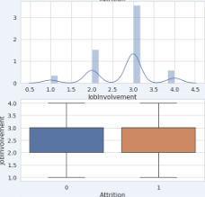
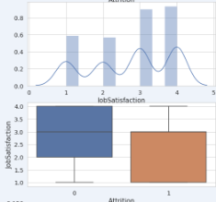
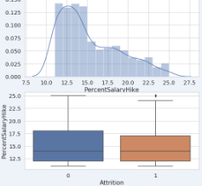
Numerical value analysis (Count<30) – (Continued)
Attrition high at lower salary hikes.
Higher job satisfaction means attrition level lesser.
Education , Job involvement does not have major impact on attrition.

Slide 8
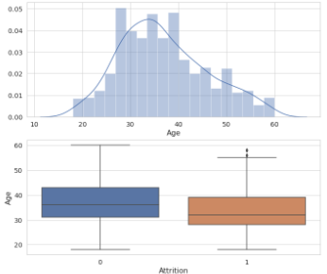
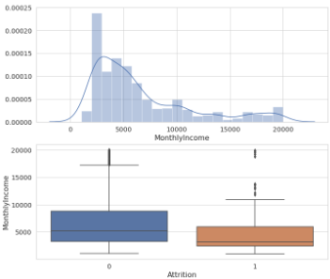
Numerical value analysis – (Count >30)
Attrition is more at age group between 27 to 35 . Age > 58 are retired employees can be considered outliers
Lesser monthly income till 6000 are quitting more. Retired employees data can be obsrved as outliers.

Slide 9
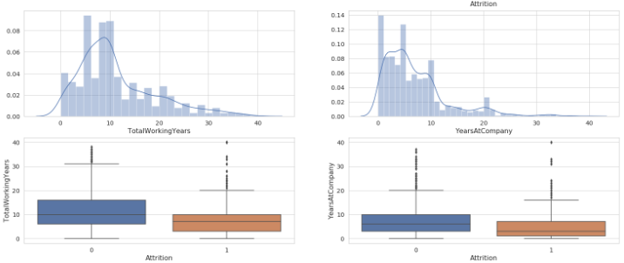
Numerical value analysis – (Count >30)(continued)
Attrition is more at employee levels having lesser the Totalworkingyears.
Employees staying less years at company are likely to quit.

Slide 10
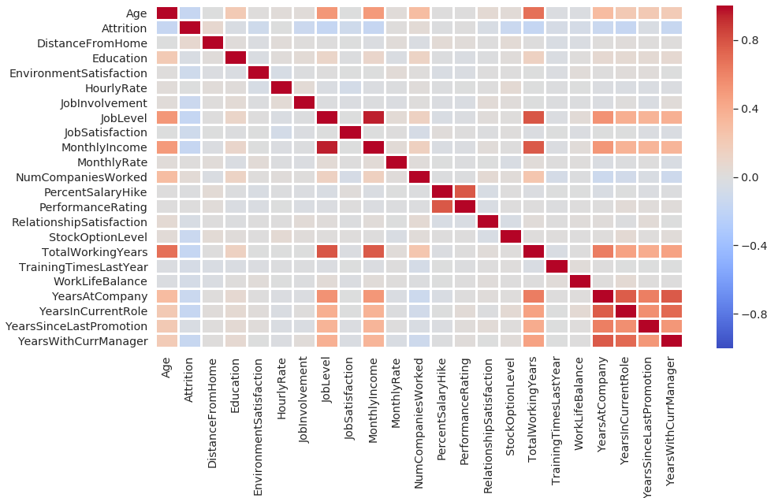
Analysis of correlation results : Attrition Influencers
Monthly income is highly correlated with Job level.
Job level is highly correlated with total working hours.
Monthly income is highly correlated with total working hours.
Age is also positively correlated with the Total working hours.
Notes:
Pandas profiling is attached

Slide 11
Key conclusions from Analysis:
Employees Percentage going for business travel is high which directly contributes to increased rate of attrition.
Employees lost in attrition tend to have longer commute distances than those who stay.
Lower the environment satisfaction, job level, job role & job satisfaction higher the attrition.
Lower the monthly income higher the attrition.
Overtime contributes to higher attrition.
Lesser the Totalworkingyears, years at company, years in current role & years with current manager, more is the attrition.
Education, Relationship satisfaction does not have significant impact on attrition.
What type of measures should the company take in order to retain their employees :
Distance from office : Since more attrition are in range on Distance 10-25 , management should proactively check consider work flexibility like WFH. 55% of active employees have distance > 10
Management should consider job rotation for those travelling frequently improve work environment
Lower the monthly income higher the attrition : So management should try to reward and review remuneration aspects of top performing employees.
Overtime contributes to higher attrition: So need to train employees to plan their work and maintain work life balance.
Lab Technicians, Other lower Job roles are more in attrition percentage. Management should help address promotion and other key aspects helping retention.

